Slide 1
Computer Networks_22CS008
ICMP, IGMP, IPv6, Transition from IPv4 to IPv6
Lecture (25-26)
Prepared By:
Dr. Shveta Bansal
Department of Computer Science and Engineering,
Chitkara University, Punjab

Slide 2
Index
Network Layer Protocols
ICMP
ICMP Messages
Format of ICMP
IGMP
IGMP messages
Query messages
IPv4 Communication
Types of IPv4 addresses
Classful Addressing
Ipv6 address
Header format
IPv6 addresses
Transition from IPv4 to IPv6

Slide 3
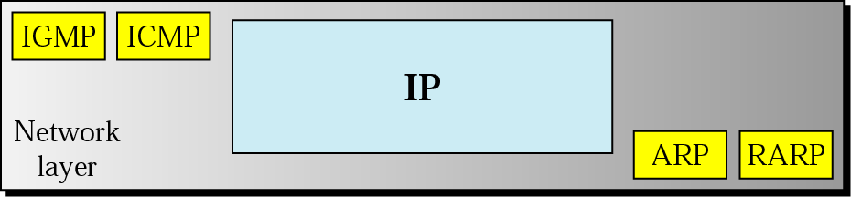
Network Layer Protocols
In order to provide efficient communication, protocols are used at the network layer.
The data is being grouped into packets or in the case of extremely large data it is divided into smaller sub packets.
Following are the Network Layer Protocols:
ARP
RARP
IPv4/IPv6
ICMP
IGMP
Figure 1 Network Layer Protocols

Slide 4
Network Layer Protocols
IP (Internet protocol): Internet Protocol helps to uniquely identify each device on the network.
IPv4: IPv4 provides with the 32 bit address scheme. IPv4 does not provide with more security features as it does not support authentication or encryption techniques.
IPv6: IPv6 is the most recent version of IP with a 128 bit addressing scheme. IP address has eight fields that are separated by colon, and these fields are alphanumeric. The IPv6 address is represented in hexadecimal. IPv6 supports end-to-end connection integrity and more range of IP address as compared to IPv4.
ARP (Address Resolution Protocol): ARP is used to convert the logical address ie. IP address into physical address ie. MAC address. While communicating with other nodes, it is necessary to know the MAC address or physical address of the destination node.
RARP (Reverse ARP): RARP works opposite of ARP. Reverse Address Resolution Protocol is used to convert MAC address ie. physical address into IP address ie. logical address.

Slide 5
ICMP
ICMP (Internet Control Message Protocol) is a part of IP protocol suite. ICMP is an error reporting and network diagnostic protocol. Feedback in the network is reported to the designated host. The messages in ICMP are divided into two types. They are given below:
-Error Message: Error message states about the issues or problems that are faced by the host or routers during processing of IP packet.
-Query Message: Query messages are used by the host in order to get information from a router or another host.
Unlike TCP and UDP, ICMP is a connectionless protocol, meaning it doesn’t require a connection to be established with the target device in order to transmit a message.
ICMP messages are transmitted within IP datagram.

Slide 6
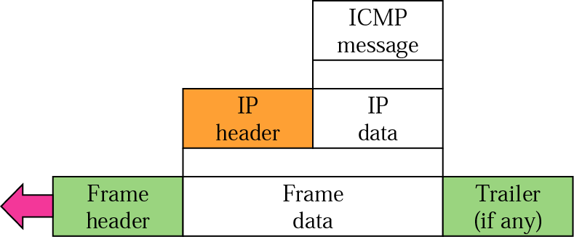

ICMP encapsulation
Figure 2 ICMP Encapsulation and format

Slide 7
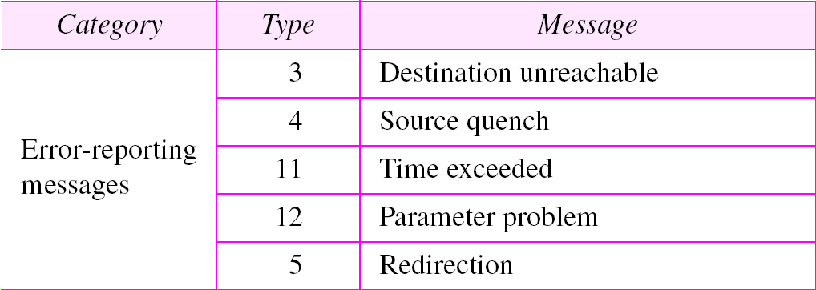
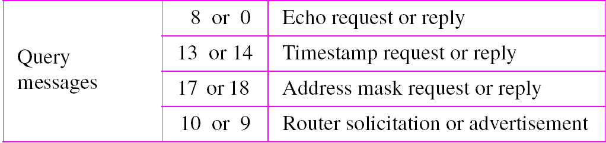
ICMP messages
Table 1 ICMP messages

Slide 8
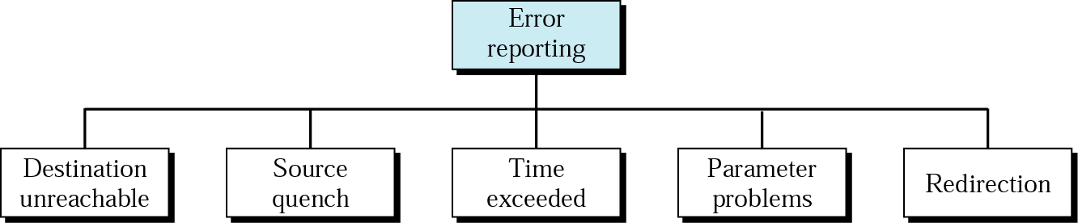
Error Reporting Messages
Figure 3 Types of Error Reporting Messages

Slide 9
Common ICMP messages
Host reachability: An ICMP Echo Message can be used to test the reachability of a host on an IP network. The local host sends an ICMP Echo Request to a host. If the host is available, the destination host responds with an Echo Reply.
Destination or Service Unavailable: When a host or gateway receives a packet that it cannot deliver, it can use an ICMP Destination Unreachable message to notify the source that the destination or service is unreachable. The message will include a code that indicates why the packet could not be delivered. ICMPv6 has similar but slightly different codes from ICMP v4.
Time Exceeded: This message is used by a router to indicate that a packet cannot be forwarded because the Time to Live (TTL) field of the packet was decremented to 0. If a router receives a packet and decrements the TTL field in the IPv4 packet to zero, it discards the packet and sends a Time Exceeded message to the source host.
ICMPv6 also sends a Time Exceeded message if the router cannot forward an IPv6 packet because the packet has expired. Instead of the IPv4 TTL field, ICMPv6 uses the IPv6 Hop Limit field to determine if the packet has expired.

Slide 10
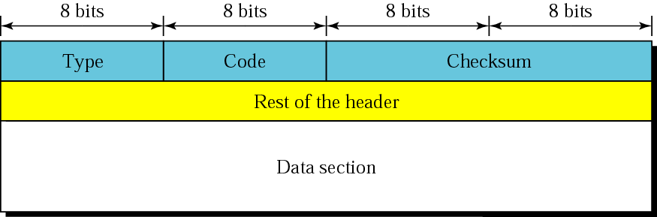
Format of ICMP messages
The first field specifies the type of the message.
The second field specifies the reason for a particular message type.
The checksum field covers the entire ICMP message.
Figure 4 General Format of ICMP Messages

Slide 11
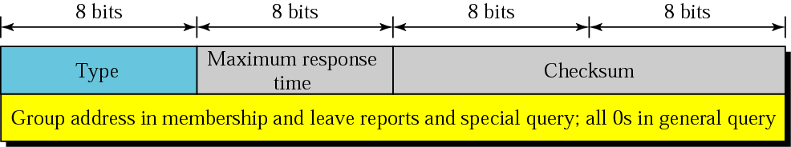
IGMP
The Internet Group Management Protocol (IGMP) is one of the necessary, but not sufficient, protocols that is involved in multicasting.
IGMP is a companion to the IP protocol.
IGMP is a group management protocol. It helps a multicast router create and update a list of loyal members related to each router interface.
The IGMP protocol is used by the hosts and router to identify the hosts in a LAN that are the members of a group.
Figure 5 IGMP Message Format

Slide 12
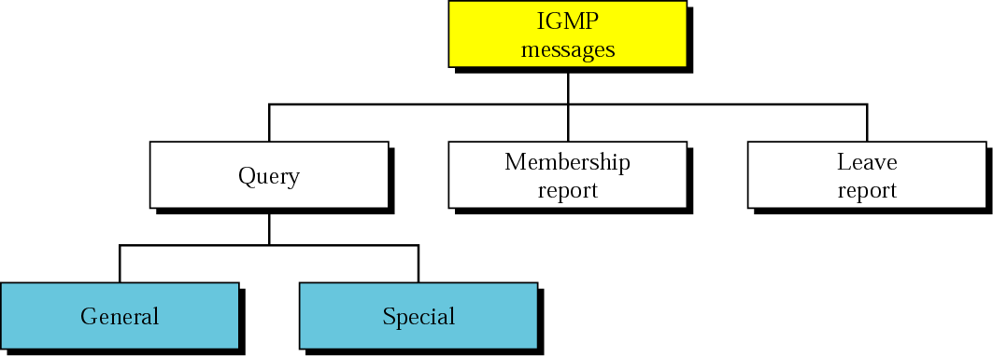
IGMP Messages
IGMP has three types of messages: the query, the membership report, and the leave report. There are two types of query messages, general and special.
Figure 6 IGMP Message Types

Slide 13
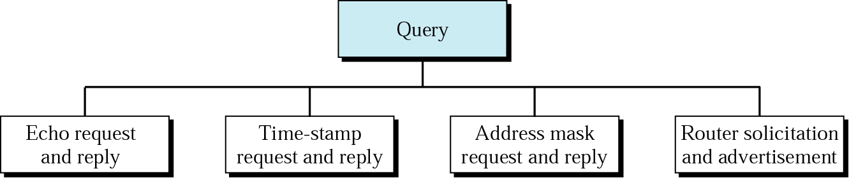
Query Messages
This message is sent by a router to all hosts on a local area network to determine the set of all the multicast groups that have been joined by the host.
Figure 7 IGMP Query Message

Slide 14
Membership and Leave report
Membership Report message
-The host responds to the membership query message with a membership report message.
-Membership report messages can also be generated by the host when a host wants to join the multicast group without waiting for a membership query message from the router.
Leave Report
-When the host does not send the "Membership Report message", it means that the host has left the group.
-The host knows that there are no members in the group, so even when it receives the next query, it would not report the group.

Slide 15
IPv4 Communication
The IPv4 protocol can be involved in three types of communication: unicasting, multicasting and broadcasting.
Unicasting is the communication between one sender and one receiver.
It is a one-to-one communication.
However, some processes sometimes need to send the same message to a large number of receivers simultaneously. This is called multicasting,
which is a one-to-many communication.
Multicasting has many applications. For example, multiple stockbrokers can simultaneously be informed of changes in a stock price, or travel agents can be informed of a plane cancellation. Some other applications include distance learning and video-on-demand.
Broadcast transmission refers to a device sending a message to all the devices on a network in one-to-all communications.
IPv4 uses broadcast packets. There are no broadcast packets with IPv6.

Slide 16
Types of IPv4 addresses
Public IPv4 addresses
Public IPv4 addresses are addresses which are globally routed between internet service provider (ISP) routers.
Private IPv4 addresses
There are blocks of addresses called private addresses that are used by most organizations to assign IPv4 addresses to internal hosts. Private IPv4 addresses are not unique and can be used internally within any network.
Special Addresses
Loopback addresses (127.0.0.0 /8 or 127.0.0.1 to 127.255.255.254) are more commonly identified as only 127.0.0.1, these are special addresses used by a host to direct traffic to itself.
Link-local addresses (169.254.0.0 /16 or 169.254.0.1 to 169.254.255.254) are more commonly known as the Automatic Private IP Addressing (APIPA) addresses or self-assigned addresses. They are used by a Windows DHCP client to self-configure in the event that there are no DHCP servers available.

Slide 17
IPv4-Classful Addressing
IPv4 addresses were assigned using classful addressing and customers were allocated a network address based on one of three classes, A, B, or C. The RFC divided the unicast ranges into specific classes as follows:
Class A (0.0.0.0/8 to 127.0.0.0/8) - Designed to support extremely large networks with more than 16 million host addresses. Class A used a fixed /8 prefix with the first octet to indicate the network address and the remaining three octets for host addresses (more than 16 million host addresses per network).
Class B (128.0.0.0 /16 - 191.255.0.0 /16) - Designed to support the needs of moderate to large size networks with up to approximately 65,000 host addresses. Class B used a fixed /16 prefix with the two high-order octets to indicate the network address and the remaining two octets for host addresses (more than 65,000 host addresses per network).
Class C (192.0.0.0 /24 - 223.255.255.0 /24) - Designed to support small networks with a maximum of 254 hosts. Class C used a fixed /24 prefix with the first three octets to indicate the network and the remaining octet for the host addresses (only 254 host addresses per network).
There is also a Class D multicast block consisting of 224.0.0.0 to 239.0.0.0 and a Class E experimental address block consisting of 240.0.0.0 - 255.0.0.0.

Slide 18
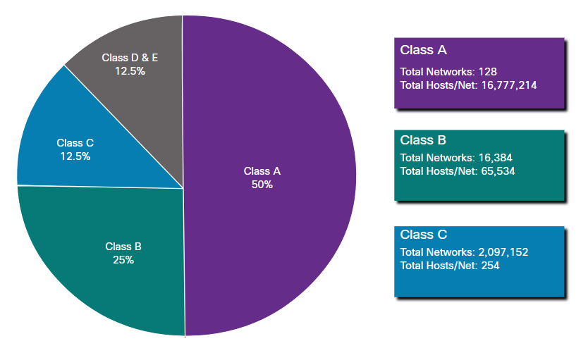
Classful addressing
Figure 8 IPv4 Classful addressing

Slide 19
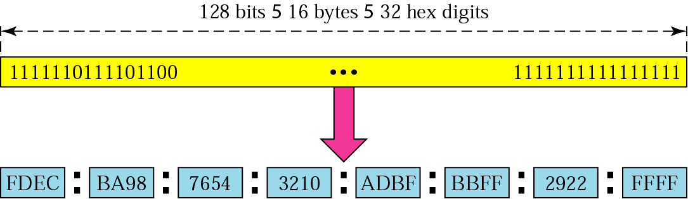
IPv6 address
IPv6 was developed by Internet Engineering Task Force (IETF) to deal with the problem of IPv4 exhaustion. IPv6 is a 128-bits address having an address space of 2¹²⁸, which is way bigger than IPv4. IPv6 use Hexa-Decimal format separated by colon (:) .
Figure 9 IPv6 Address Format

Slide 20
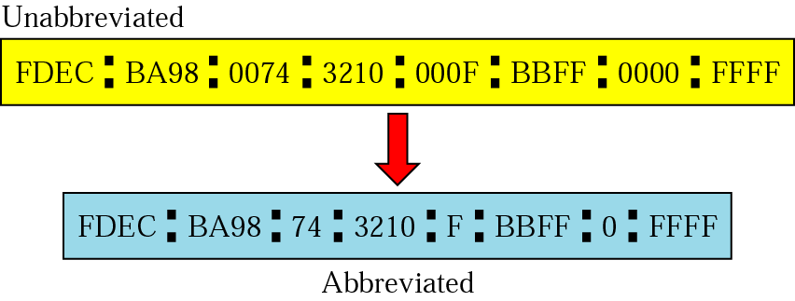
Abbreviated Address
Figure 10 IPv6 Abbreviated Address

Slide 21
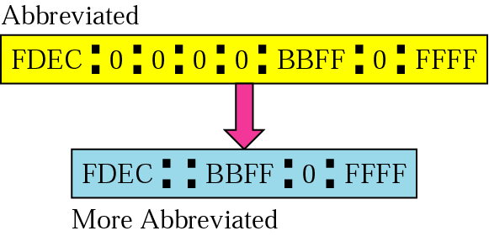
Abbreviated address with consecutive zeros
Figure 11 IPv6 Abbreviated Address with Consecutive Zeros

Slide 22
CIDR address
Classless or Classless Inter-Domain Routing (CIDR) addresses use variable length subnet masking (VLSM) to alter the ratio between the network and host address bits in an IP address.
A subnet mask is a set of identifiers that returns the network address’s value from the IP address by turning the host address into zeroes.
For example, 192.0.2.0/24 is an IPv4 CIDR address where the first 24 bits, or 192.0.2, is the network address
Figure 12 IPv6 CIDR Address Format

Slide 23
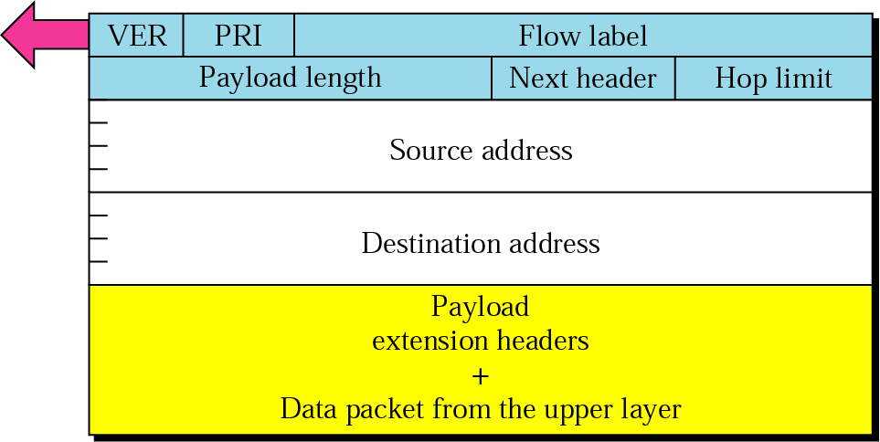
Format of an IPv6 Header
Figure 13 IPv6 Datagram Format
Notes:
Version, Priority,

Slide 24
IPv6 Header fields
IPv6 Fixed Header is a part of the information sent over the internet and always 40 bytes long.
Version (4-bits): The size of this field is 4-bit. Indicates the version of the Internet Protocol, which is always 6 for IPv6, so the bit sequence is 0110.
PRI (8-bits): The Traffic Class field indicates class or priority of IPv6 packet which is similar to Service Field in IPv4 packet. It helps routers to handle the traffic based on the priority of the packet. If congestion occurs on the router then packets with the least priority will be discarded.
Flow Label (20-bits): Flow Label field is used by a source to label the packets belonging to the same flow in order to request special handling by intermediate IPv6 routers.
Payload Length (16-bits): It is a 16-bit (unsigned integer) field, indicates the total size of the payload which tells routers about the amount of information a particular packet contains in its payload.
Next Header (8-bits): Next Header indicates the type of extension header(if present) immediately following the IPv6 header.
Hop Limit (8-bits): Hop Limit field is the same as TTL in IPv4 packets. It indicates the maximum number of intermediate nodes IPv6 packet is allowed to travel.
Extension Headers: In order to rectify the limitations of the IPv4 Option Field, Extension Headers are introduced. The next Header field of IPv6 fixed header points to the first Extension Header and this first extension header points to the second extension header and so on.

Slide 25
IPv6 Addresses
Address Type | Description
Unicast | One to One (Global, Link local, Site local) + An address destined for a single interface.
Multicast | One to Many + An address for a set of interfaces + Delivered to a group of interfaces identified by that address. + Replaces IPv4 “broadcast”
Anycast | One to Nearest (Allocated from Unicast) + Delivered to the closest interface as determined by the IGP

Slide 26
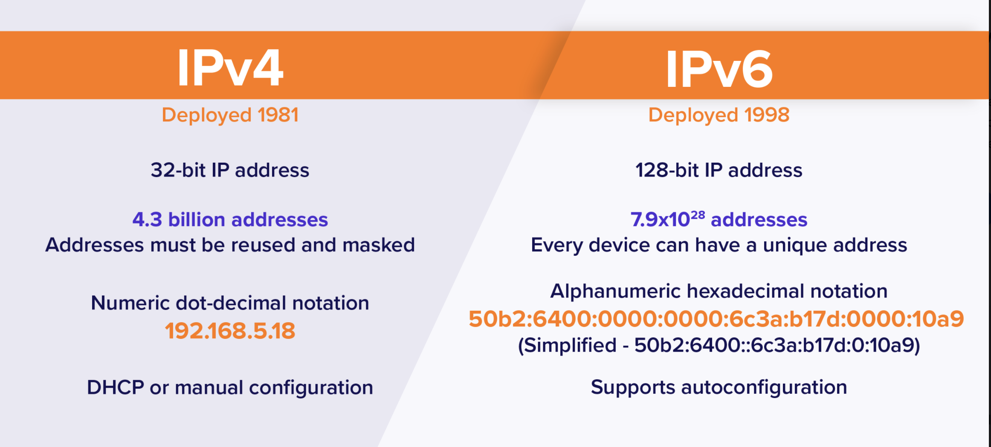
IPv4 Vs IPv6

Slide 27
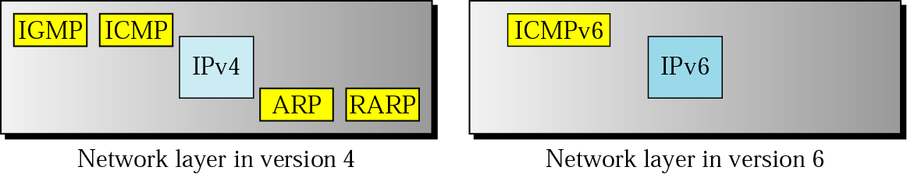
Comparison of network layers in version 4 and version 6
Figure 14 Comparison of Network Layers in IPv4 and IPv6

Slide 28
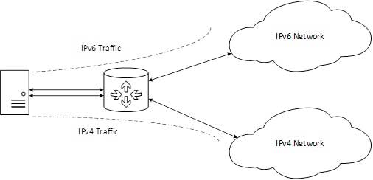
Transition from IPv4 to IPv6
Complete transition from IPv4 to IPv6 might not be possible because IPv6 is not backward compatible.
For a solution to this problem, we use some technologies.-
1. Dual-Stack Routers: In dual-stack router, A router’s interface is attached with IPv4 and IPv6 addresses configured are used in order to transition from IPv4 to IPv6.
Figure 15 Dual Stack Routers

Slide 29
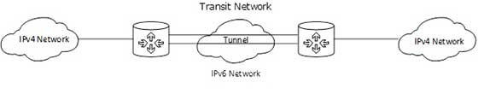
Transition from IPv4 to IPv6
2. Tunneling
-In a scenario where different IP versions exist on intermediate path or transit networks, tunneling provides a better solution where user’s data can pass through a non-supported IP version.
-The diagram depicts how two remote IPv4 networks can communicate via a Tunnel, where the transit network was on IPv6. Vice versa is also possible where the transit network is on IPv6 and the remote sites that intend to communicate are on IPv4.
Figure 16 Tunneling

Slide 30
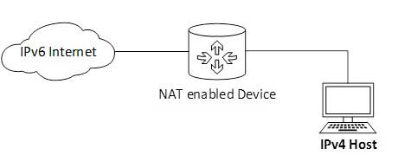
Transition from IPv4 to IPv6
3. NAT Protocol Translation
This is another important method of transition to IPv6 by means of a NAT-PT (Network Address Translation – Protocol Translation) enabled device. With the help of a NAT-PT device, actual can take place happens between IPv4 and IPv6 packets and vice versa.
Figure 17 NAT

Slide 31
Practice Questions
Question 1
ICMP always reports error messages to ------- during error reporting.
Source
Destination
Station
None of these
Question 2
The Internet Control Message Protocol (ICMP) is the companion of -----.
IP Transmission
IP Packet
IP Frame
IP protocol

Slide 32
Practice Questions
Question 3
The Internet Control Message Protocol (ICMP) has the header size of ----- .
12 bytes
10 bytes
8 bytes
32 bytes
Question 4
The Internet Control Message Protocol (ICMP) messages are divided into two broad categories namely ---------.
Query and error reporting messages
Request and response messages
Request and reply messages
None of the above

Slide 33
Practice Questions
Question 5
IGMP stands for -------- .
Internet Group Management Package
Internet Group Management Path
Internet Group Management Protocol
Internet Group Management Ping
Question 6
The Internet Protocol (IP) packet that carries an Internet Group Management Protocol (IGMP) packet has a value of ------- .
0
1
2
-1

Slide 34
Practice Questions
Question 7
Internet Protocol Version (IPv6) has a larger address space of -------- .
2¹⁶
2³²
2⁶⁴
2¹²⁸
Question 8
The Internet Protocol Version 4 (IPv4) address is displayed as ------- .
4 bits
8 bits
16 bits
32 bits

